Slide 1

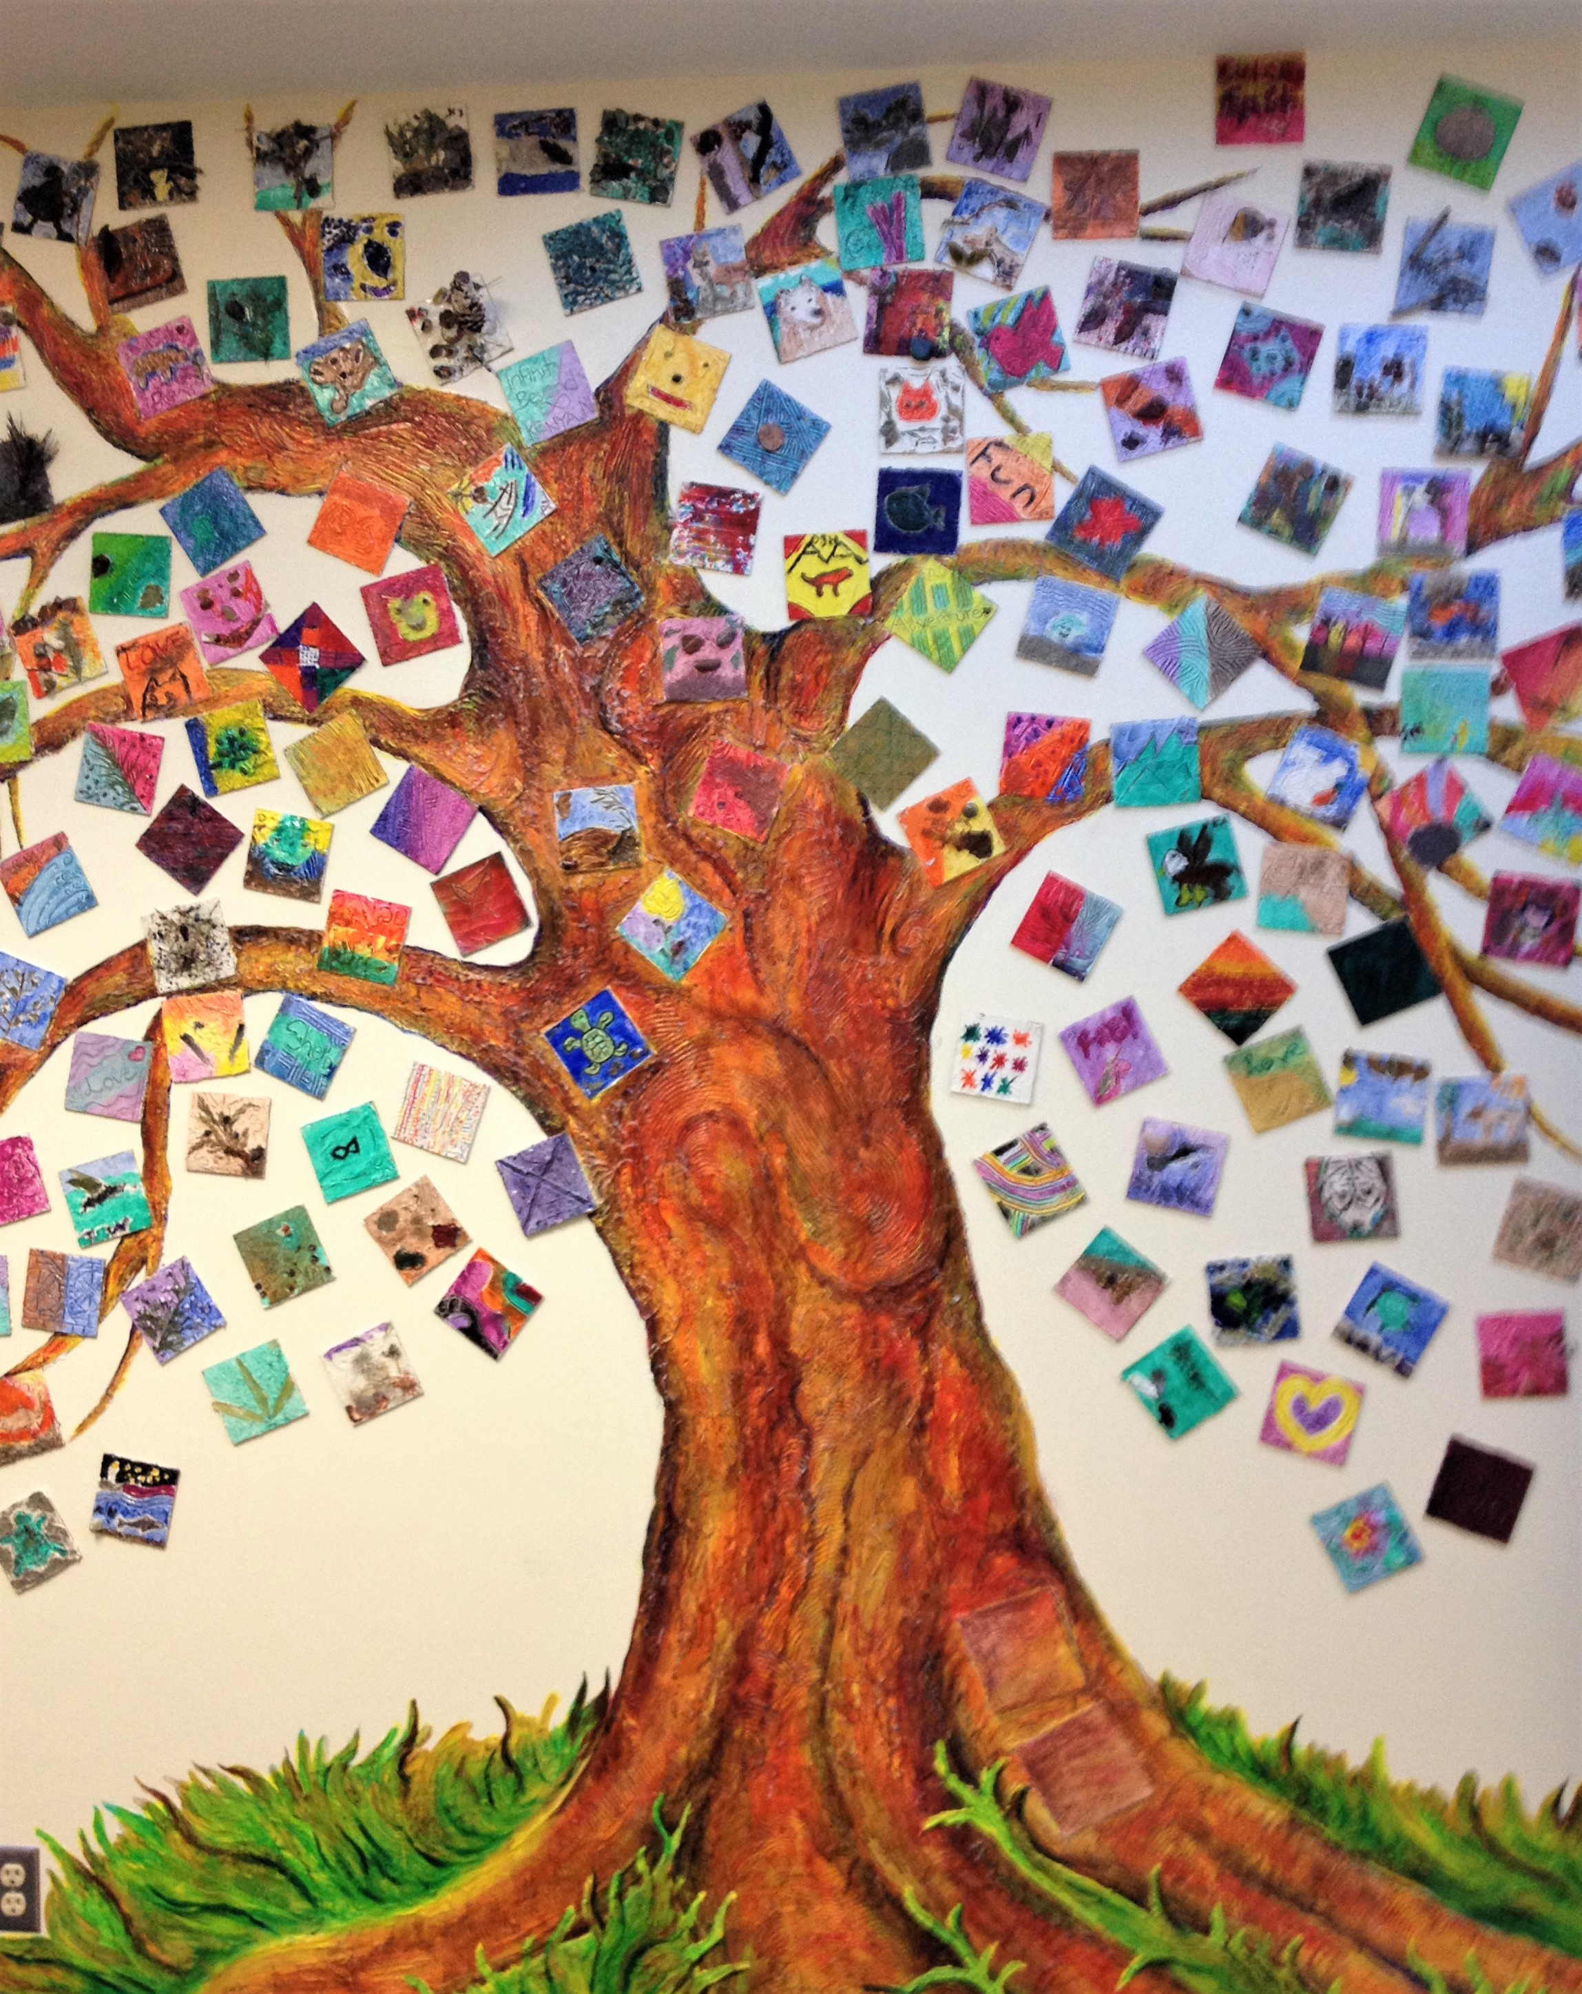
September 2022
École Lady Grey Elementary School

Slide 2

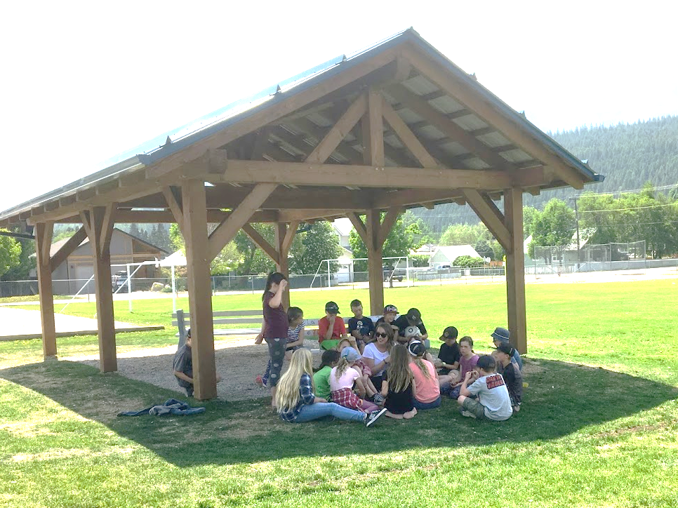
École Lady Grey Elementary School is situated on unceded and crossover territories
of the Secwépemc and Ktunaxa People and is home of the Métis Nation Columbia River Society.
Throughout the 2021-22 school year, school staff frequently met to discuss student achievement and progress of the School Success Plan. In the spring of 2022, we gathered to identify and celebrate accomplishments, and determine areas of growth and improvement for the upcoming school year.
We used a variety of data sources (student learning surveys, report cards, F & P reading assessment, SNAP, FSA) and sought input from staff, parents and district partners to arrive at our goals. Our School Success Plan is aligned with Rocky Mountain School District’s three areas for school improvement: Equity and Inclusion, Success for all Learners, and Excellence in Teaching and Leadership. We have identified student belonging, and achievement in literacy and numeracy as areas for growth.
As we meet and examine achievement throughout the upcoming school year, we will be adjusting our approach based on evidence of growth and need. Additionally, we will be paying particular attention to the growth of Grade 6 students (last year’s Grade 5 students) and students that are Indigenous.
I learn, I lead, We Succeed at Lady Grey!
J'apprends, Je mène, Nous réussissons à Lady Grey!

Slide 3
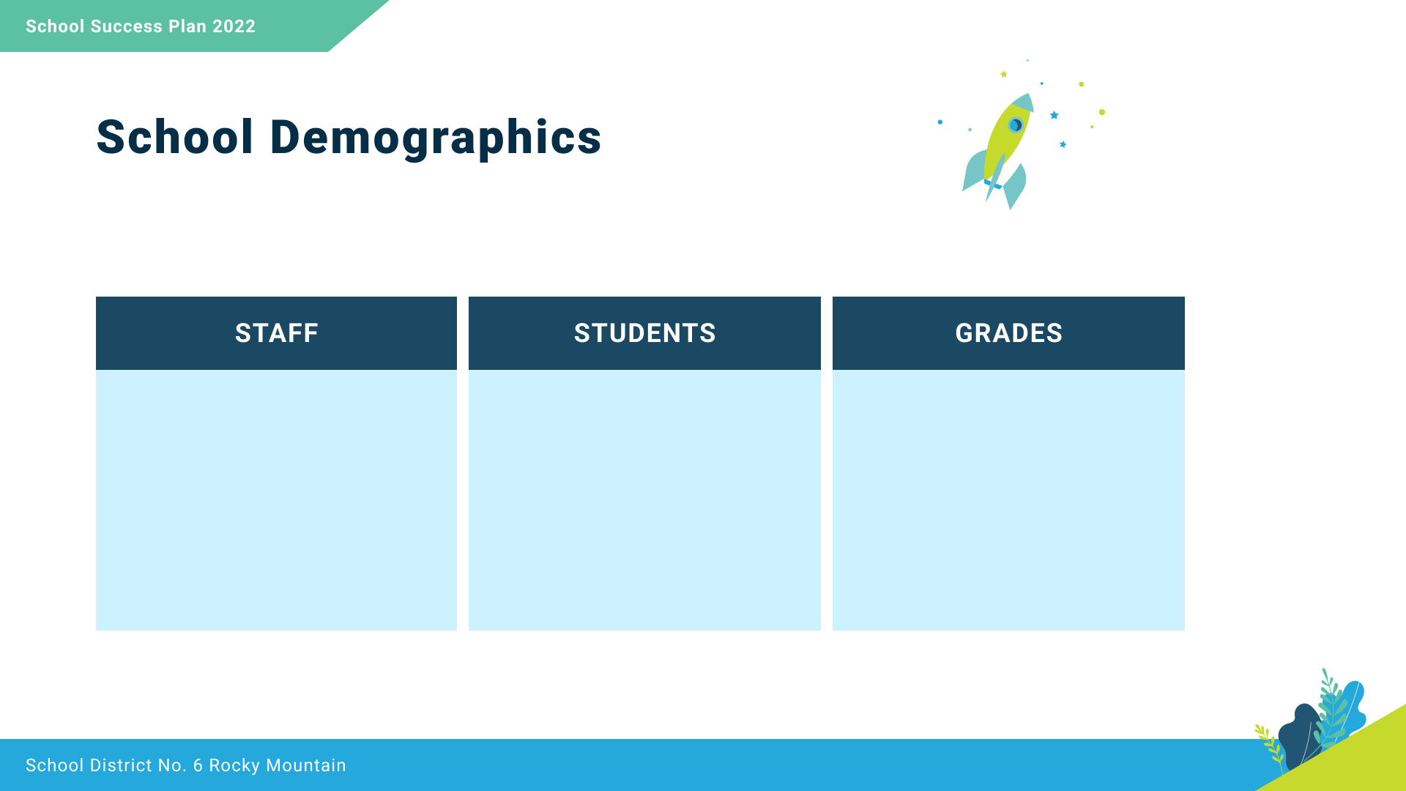
12 Teachers
10 Support Staff
228 Students
(53 Indigenous Students)
4 - 7

Slide 4

We collaborate in the pursuit of each student’s success as knowledgeable, caring, resilient, and contributing members of a global community.
Respect
We foster respectful relationships that build trust, safety and well-being.
Equity
We strive to build learning environments that are equitable, honour diversity and inclusion, are safe, caring and healthy places to work and learn.
Integrity
We nurture a sense of self-awareness, responsibility and honesty to become environmental stewards and morally upright global citizens.
Accountability
We are accountable for ourselves, our students and our communities for professionalism, transparency and quality results.
Innovation
We create learning opportunities that are high quality, place-based, creative, and that encourage students to reach their full potential.
Opportunity, equity, and success for ALL learners

Slide 5
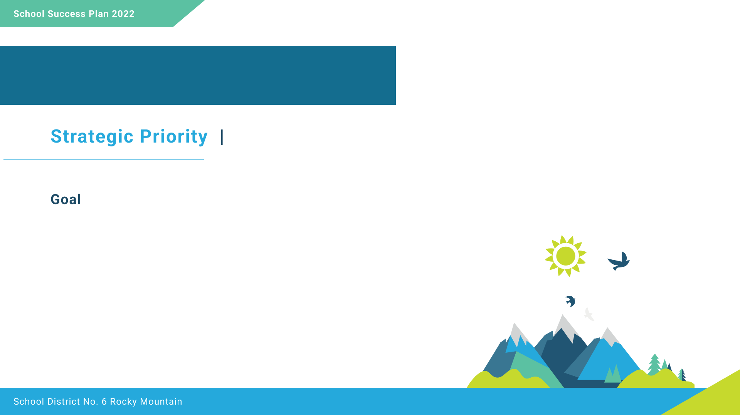
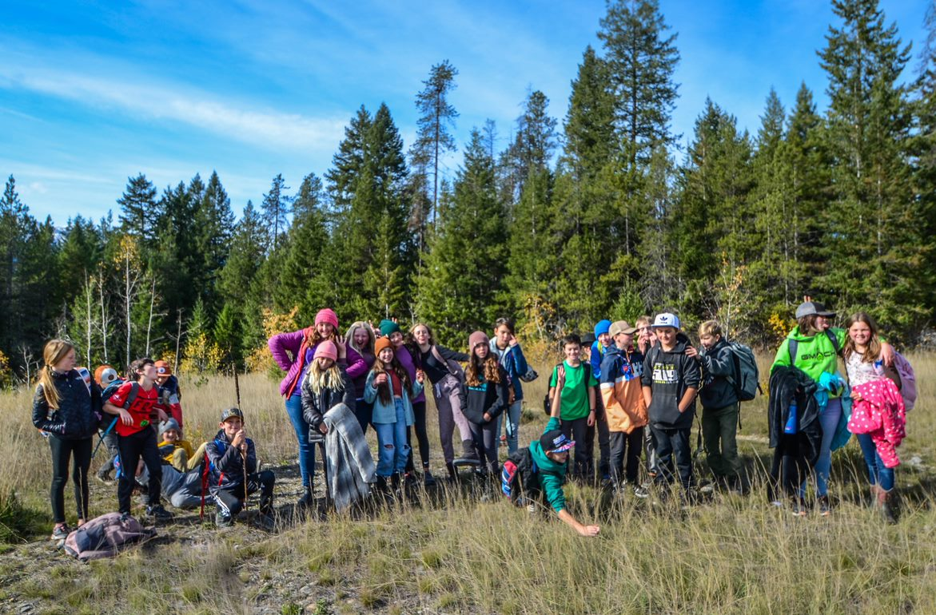

Strategic Priority 1
Increase student sense of belonging.

Slide 6

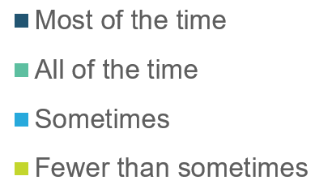
One of the questions on the Grade 4 and 7 Student Learning Survey asks “Is school a place where you feel like you belong?”
The results tell us that approximately 1 in 5 students does not feel like they always belong at school. This requires the continued attention of staff, as a healthy sense of belonging is positively associated with academic success and motivation.

Slide 7
The Middle Years Development Instrument (MDI) is a self-report questionnaire completed by Grade 5 students during the 2021-22 school year. It asks students how they think and feel about their experiences inside and outside of school.
School belonging is the degree to which children feel connected and valued at their school. For example, “I feel like I am important to this school.” These results tell us that 1 in 4 Grade 5 students (Grade 6 students in 2022-23) are not feeling a significant connection to school. We will follow this cohort of students closely for the upcoming year.

Slide 8
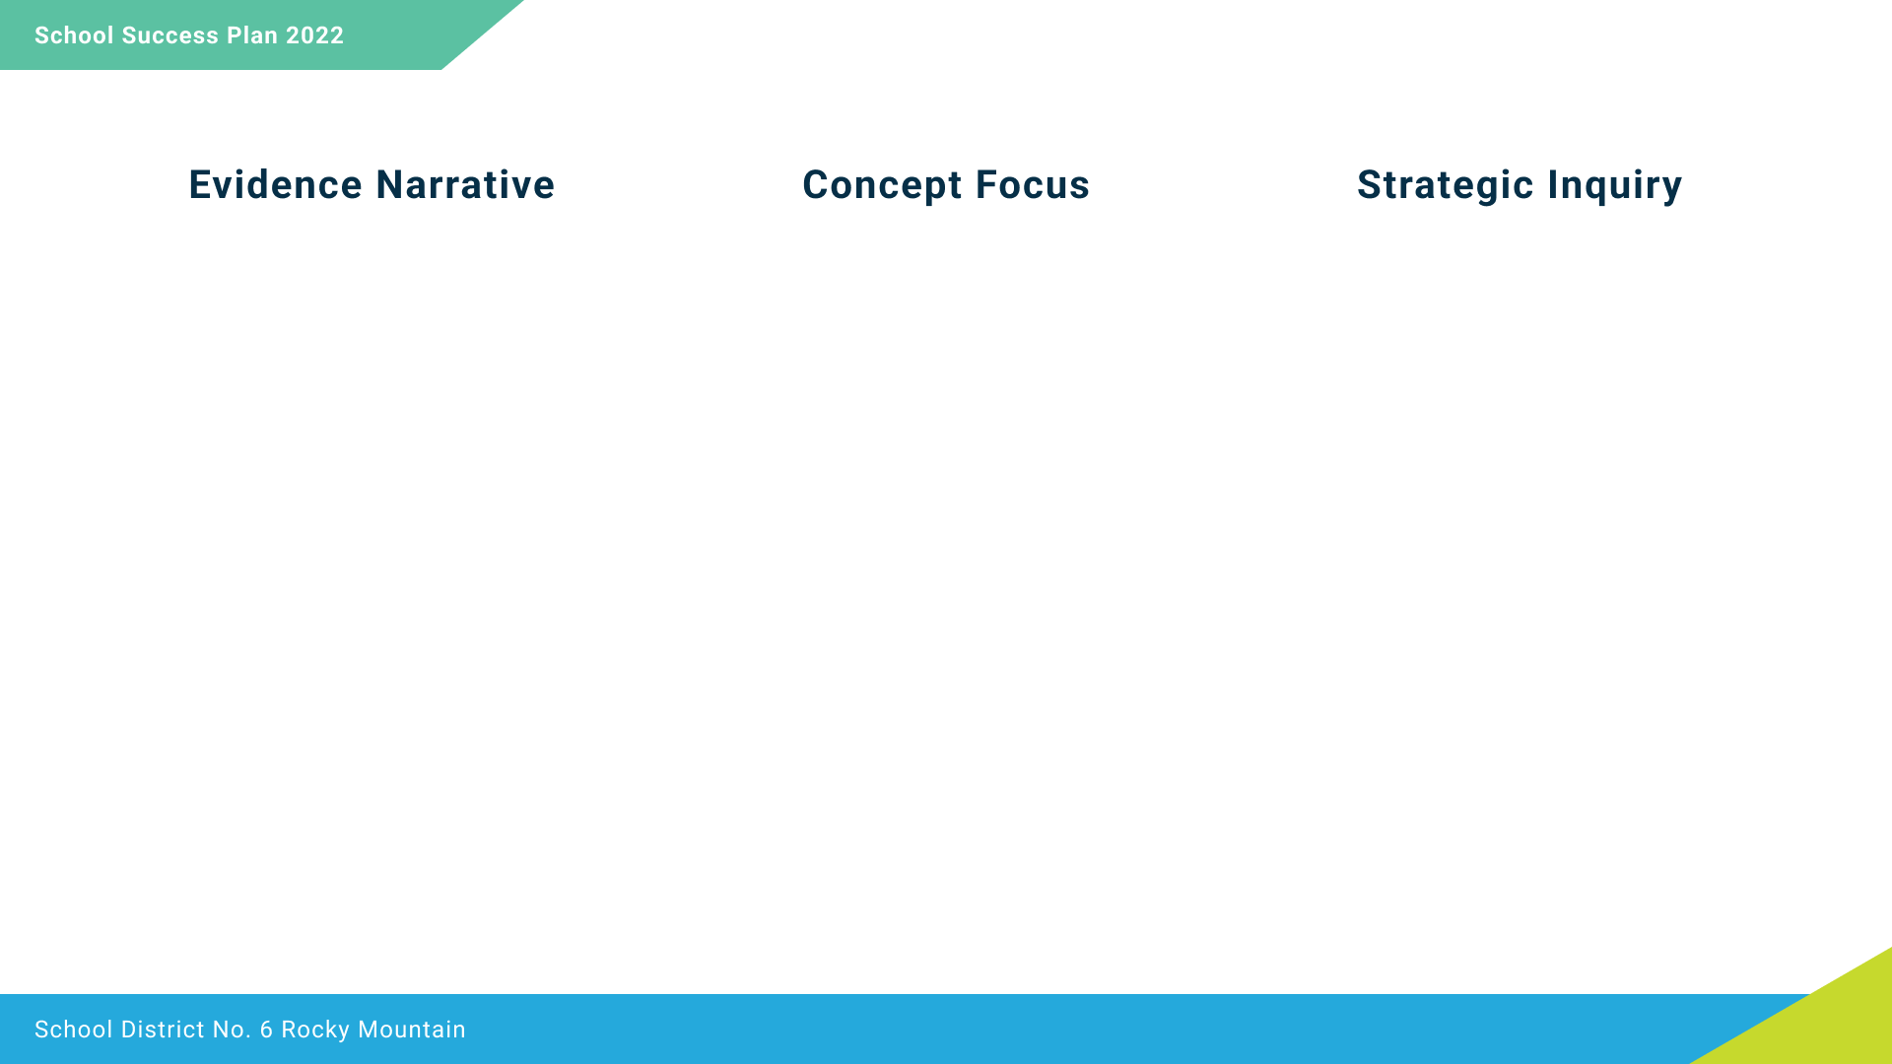
While the Student Learning Survey showed growth in student sense of belonging, the MDI indicated that 26% of Grade 5 students have a low feeling of connection to school.
We suspect that the transition to a new school, the pandemic, and not knowing the adults in the building had a negative effect. We want to increase this number as learning happens best when students’ socio-emotional needs are met.
Student sense of belonging will improve with increased positive interactions with peers and adults at Lady Grey.
To what extent will student sense of belonging increase if all staff connect with students in weekly school-culture building activities?

Slide 9
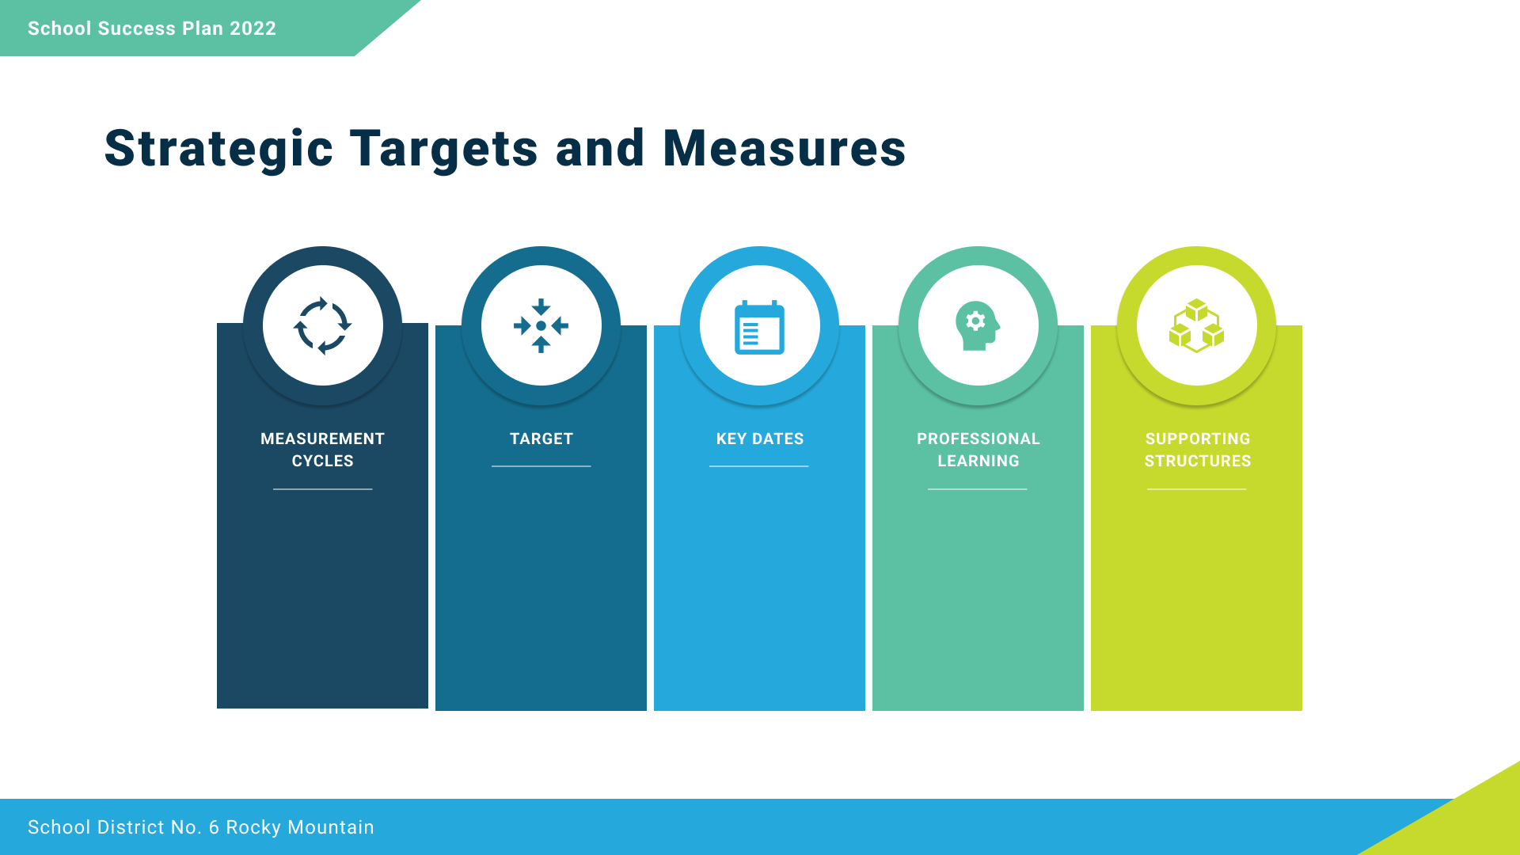
- Show continuous improvement on monthly school questions
- 80% of students reporting Most of the Time or All of the Time on the SLS
- Monthly staff meetings
- Term review of locally developed questionnaire
- 4 Seasons Reconciliation Ed course at staff meetings
- Trauma-informed pro-d possibilities on pro-d days
- NVCI training
- Review student belonging information monthly at all staff meetings
- Friday collaborative block
- School-culture assemblies
- Lunchtime clubs
- Instructional rounds

Slide 10
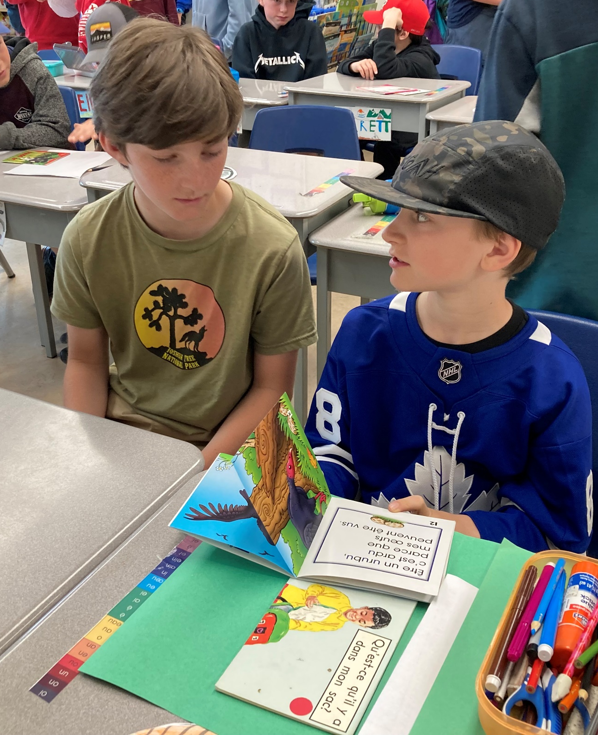
Strategic Priority 2
Increase student achievement in literacy.

Slide 11
The 2022 FSA results indicate that Indigenous learners are performing at the same level, or better on the Literacy portion of the FSA. This is encouraging news.
Non-Indigenous Learners
Indigenous Learners

Slide 12
When examined more closely, the achievement gap in literacy between Indigenous and non-Indigenous learners appears in the lower-end of on-track performance.
Non-Indigenous
Percentage of Students

Slide 13
The May 2022 Fountas & Pinnell reading data shows us that more than 60 students in all grades are performing at the emerging level in reading. This represents more than 25% of the school population.

Slide 14
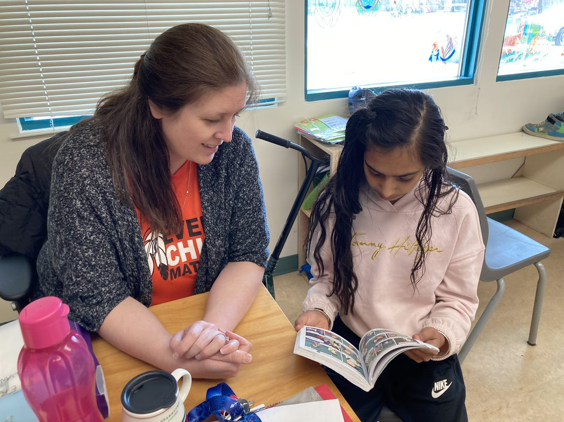
The Student Learning Survey allows students to self-report. One of the statements on the Grade 4 and 7 survey is “I am getting better at reading.”
The majority of students report that they feel they are getting better at reading, but 16% feel that they are not. We wonder who these students are, and what they would report on their core competencies self-assessments.

Slide 15
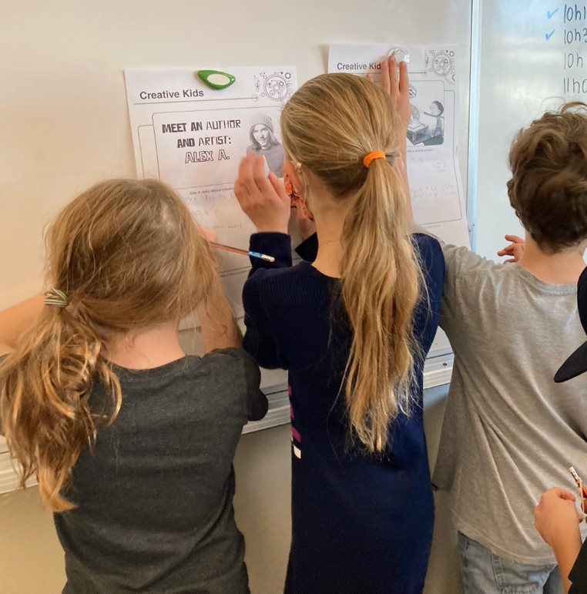
Evidence from reading assessments, report card data, and FSA results all show that students require the ability to make meaning from what they read. This is called comprehension.
Our focus will be on increasing student ability to make meaning by communicating (speaking, sketching, and writing) key ideas and justifying their thinking and opinions about what they are listening to, viewing, and reading.
To what extent will staff implementing a monthly strategy for teaching reading comprehension increase student achievement?

Slide 16
- 80% Proficient or better on report cards in ELA
- 90% On track on Literacy FSA
- October 30 district assessment review
- FSA review Dec.
- Report card review Dec. April June
- Monthly review of Emerging readers
- Monthly review of comprehension data (classroom evidence)
- FSA review
- Report card review
- Monthly learning focus staff meetings, modeling strategy of the month
- Shared proficiency benchmark language
- Pro-D Sept & follow up in January?
- Staff meetings
- Support from District Literacy Team
- Instructional rounds

Slide 17
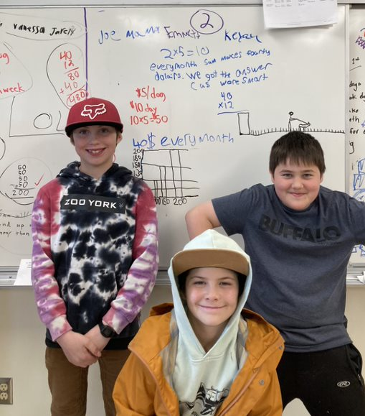
Strategic Priority 2
Increase student achievement in numeracy.

Slide 18
The 2022 FSA results indicate that Indigenous learners are not performing at the same level as non-Indigenous students on the numeracy portion of the FSA. There is a significant achievement gap.
Non-Indigenous
Indigenous

Slide 19
June report card information indicates there an achievement gap in literacy between Indigenous and non-Indigenous learners. Indigenous learners are over-represented at the lower end of on-track results.
Percentage of students

Slide 20
The SNAP numeracy assessment indicated that there was a lot of growth in the number of students achieving a score of 3 (proficient or better) between the fall and spring assessments. We want all students to be proficient in number sense so they can be successful in more complex numeracy tasks.

Slide 21
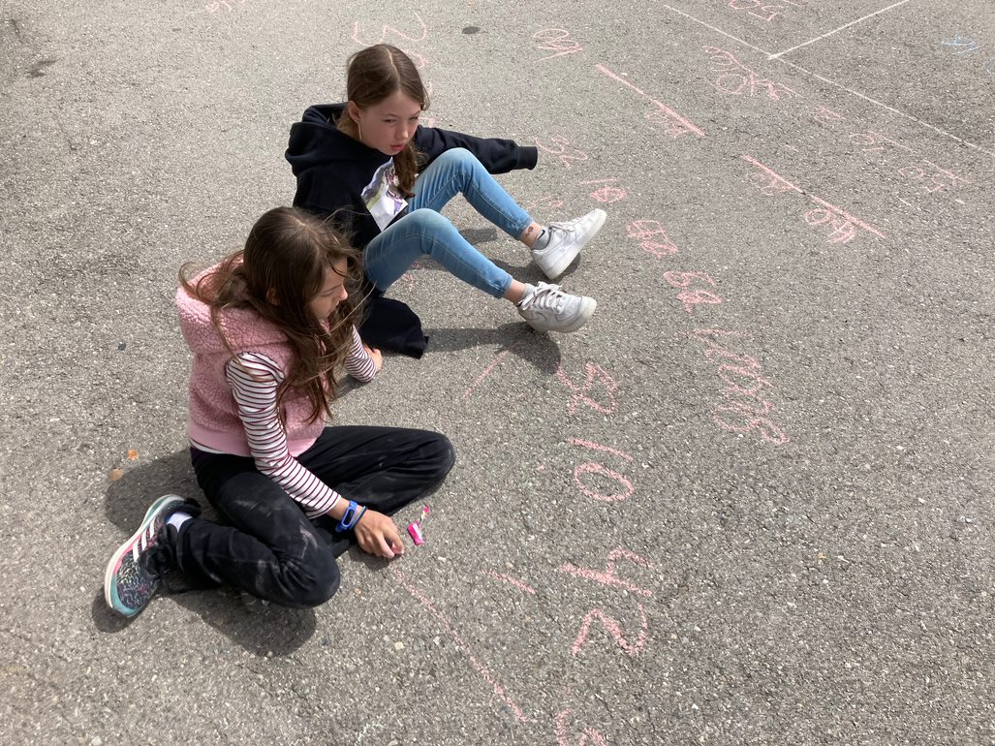
The Student Learning Survey allows students to self-report. One of the statements on the Grade 4 and 7 survey is “I am getting better at math.”
The majority of students report that they feel they are getting better at reading, but 27% feel that they are not. This is concerning; it points to a lack of engagement and low confidence in math, which contributes to low achievement.

Slide 22
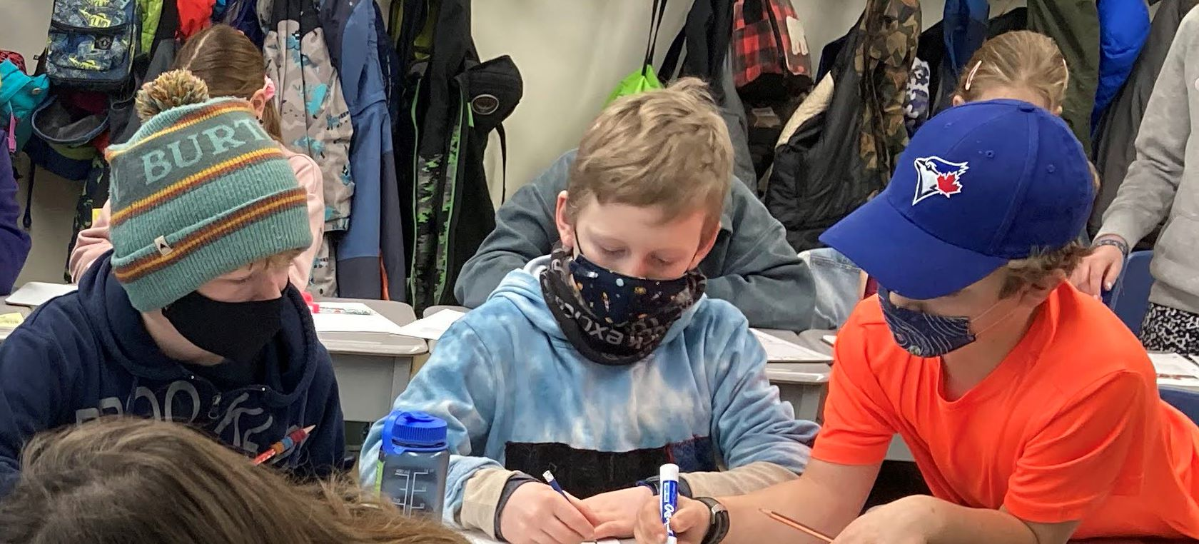
We have seen through numeracy assessments (SNAP, FSAs) and report card data that certain students have a lot of difficulty initiating a plan of approach to solve math problems. Students have a hard time getting going when solving math problems.
Our focus will be on increasing student ability to interpret the task and apply strategies when solving math problems.
To what extent will staff using numeracy tasks and visible thinking strategies (on a weekly basis) increase student engagement and achievement?

Slide 23
- 75% Proficient or better on report cards in Math
- 80% On track on Num. FSA
- 70% Proficient on SNAP
- October 30 district assessment review
- FSA review Dec.
- End of term review of Report Card data
- Monthly review of student data
- SNAP twice a year
- FSA once a year
-Report Card data review
- Monthly review of student data
- Monthly learning focus staff meetings, modeling strategy of the month
- Shared proficiency benchmark language
- Pro-D Sept & follow up in January?
- Staff meetings
- Support from District Numeracy Team
- Instructional rounds

Slide 24
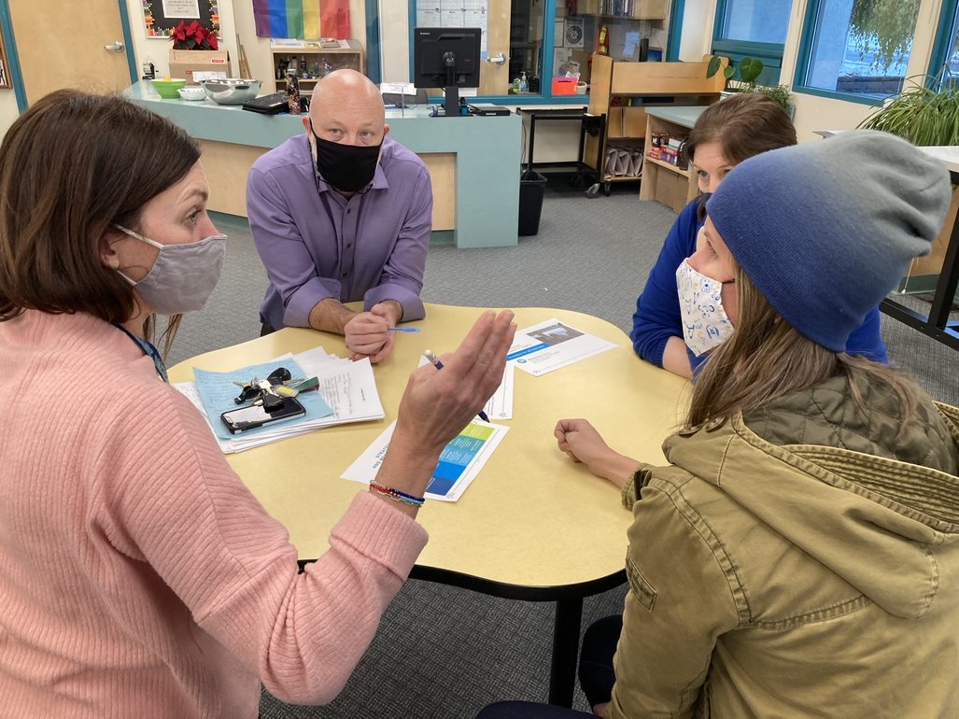

Strategic Priority 3
Improve the quality and frequency of staff collaboration.

Slide 25
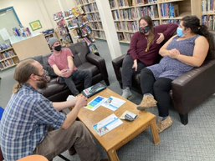
Measure: Teachers report that the quality and frequency of collaboration (collaboration rubric?) improves.
2021-22
Teachers who participated in Instructional Rounds at least once
7/12
2022-23
Teachers who participated in Instructional Rounds at least twice
12/12

Slide 26
Collegial culture and collaborative professional learning has been very difficult over the past two years, and we aim to reinvigorate this through learning rounds.
Our focus will be on professional collaboration, looking specifically at student sense of belonging, reading comprehension, and numeracy tasks.
To what extent will teachers report that the quality of collaboration has increased over the course of the year if they participate in instructional rounds?

Slide 27
- Monthly learning rounds & sharing out at staff meetings
- Pre and Post teacher assessment
- 100% of teachers report that the quality of collaboration has improved
- Pre assessment in Fall 2022
- Post assessment in Spring 2023
- Instructional rounds ongoing
- PVP & Assistant Superintendent lead discussions (how to make non-judgmental observations)
- Staff meetings
- Support from district leadership team

Slide 28
